Slide 1


Online Safety:
How to Stay Secure on the Internet
What is Online Safety?
Online safety means protecting yourself, your
personal information, and your devices while using the internet. This helps you avoid scams, hackers, viruses, and online threats.
by Ram N Java

Slide 2
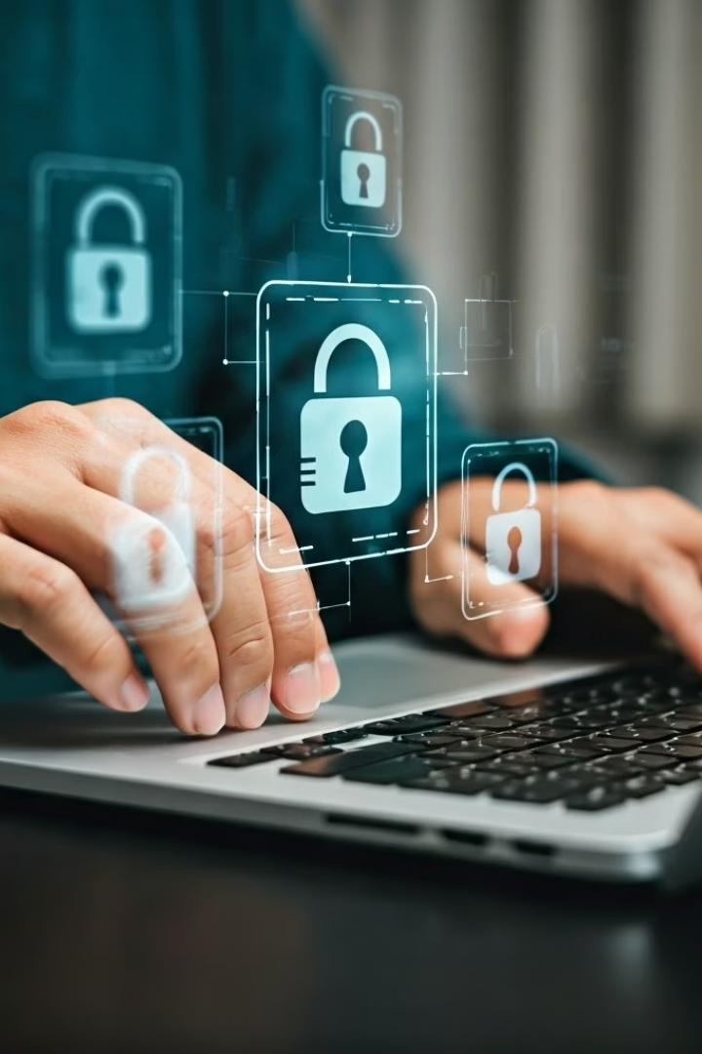



Use Strong Passwords
Create Complex Passwords
Avoid Common Mistakes
A strong password is hard to guess.
Avoid using names, birthdays, or simple passwords like 123456 or password.
Use a mix of letters, numbers, and symbols (like @ or #).
Example: P@ssw0rd!23
Password Management
Use a different password for each account.
Tip: If remembering passwords is hard, use a password manager (like Bitwarden or Google Password Manager).

Slide 3
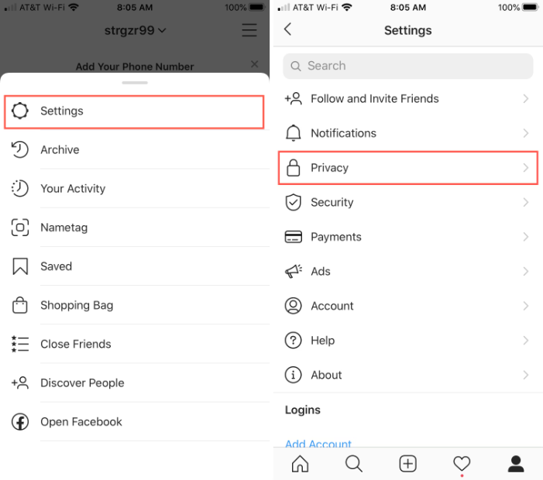
Never Share Personal Information
Information to Protect
Privacy Settings
Do not share your home address, phone number, bank details, or passwords online unless it's a trusted website.
Check privacy settings on Facebook, Instagram, etc.
Be careful what you share on social media. Strangers can use it to trick or harm you.

Slide 4
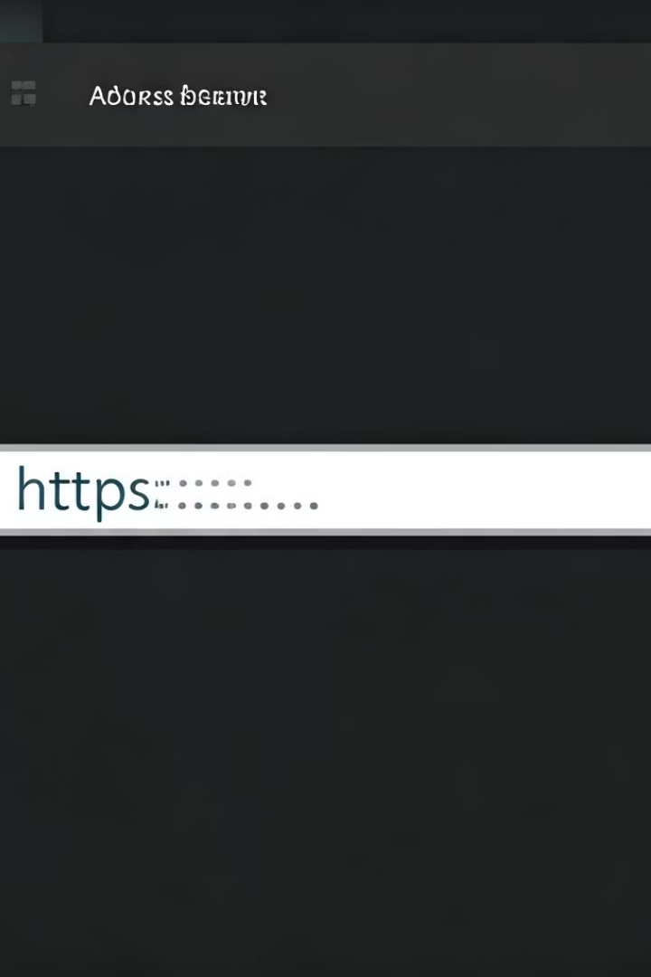
Use Trusted Websites Only
Website Security Basics
Always check if a website starts with https:// (the "s" means secure).
Avoid clicking on strange or suspicious links.
Don't download files from unknown websites.
Recognize Fake Websites
Check the website URL:
Safe: https://www.amazon.com (with a padlock icon).
Fake: http://amaz0n-login.com (no "s" in "http").
Never enter passwords on suspicious sites.

Slide 5



Keep Software Updated
Why Updates Matter
Hackers exploit old software to steal data.
What to Update
Your phone/computer's operating system.
Web browsers (Chrome, Firefox, Edge).
Apps (especially banking and social media).
Make It Easy
Tip: Turn on automatic updates in your device settings.

Slide 6
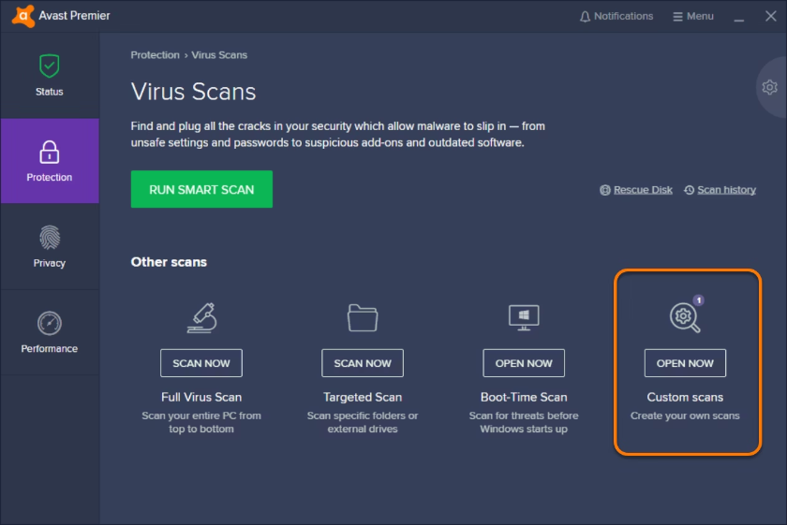
Install Antivirus Software
Computer Protection
Mobile Device Safety
Viruses and malware can steal your data or damage your device.
For phones:
Use free antivirus like Windows Defender (PC) or Avast.
Only download apps from Google Play Store or Apple App Store.
Avoid pirated software—they often contain malware.
Check app reviews before installing.

Slide 7




Beware of Phishing Emails and Messages
What is Phishing?
Phishing is when someone pretends to be a trusted company to steal your info.
Warning Signs
Watch for emails or texts that ask for your passwords, bank info, or ask you to click suspicious links.
Safety Rules
If unsure, don't click anything. Check with the real company's website.
Do not click on links in strange emails or messages from people you don't know.
Best Practices
If you get an email from someone you don't know, don't open attachments or click on links.
Even if an email looks real, it could be a fake (called phishing).
Rule: If an email/message seems too good to be true (e.g., "You won a prize!"), it's probably a scam.

Slide 8
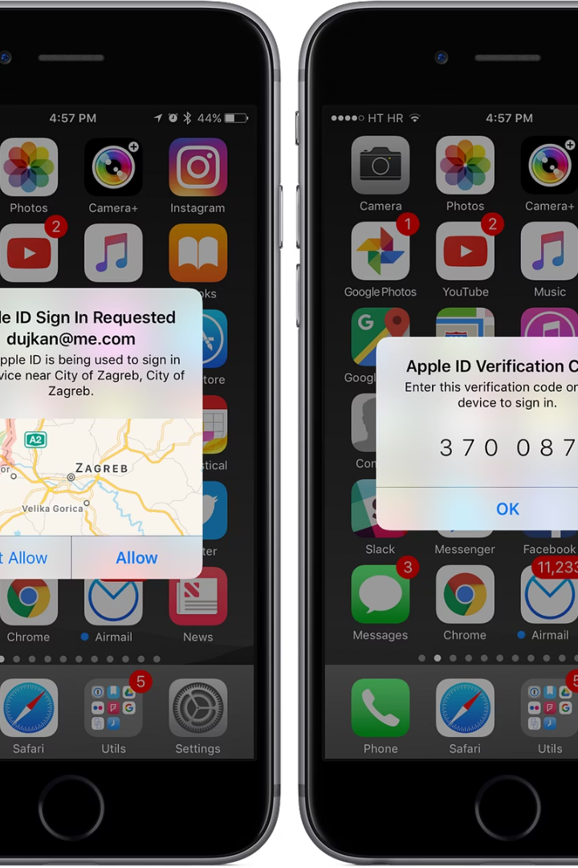
Use Two-Factor Authentication (2FA)
What is 2FA?
2FA adds an extra layer of security to your accounts.
After entering your password, you also enter a code sent to your phone or email.
Where to Use It
Use 2FA on important accounts like email, bank, and social media.
How to Enable 2FA
Go to account settings (in Gmail, Facebook, etc.).
Look for "Security" → "Two-Factor Authentication."
Follow the steps (usually phone number or authentication app).

Slide 9
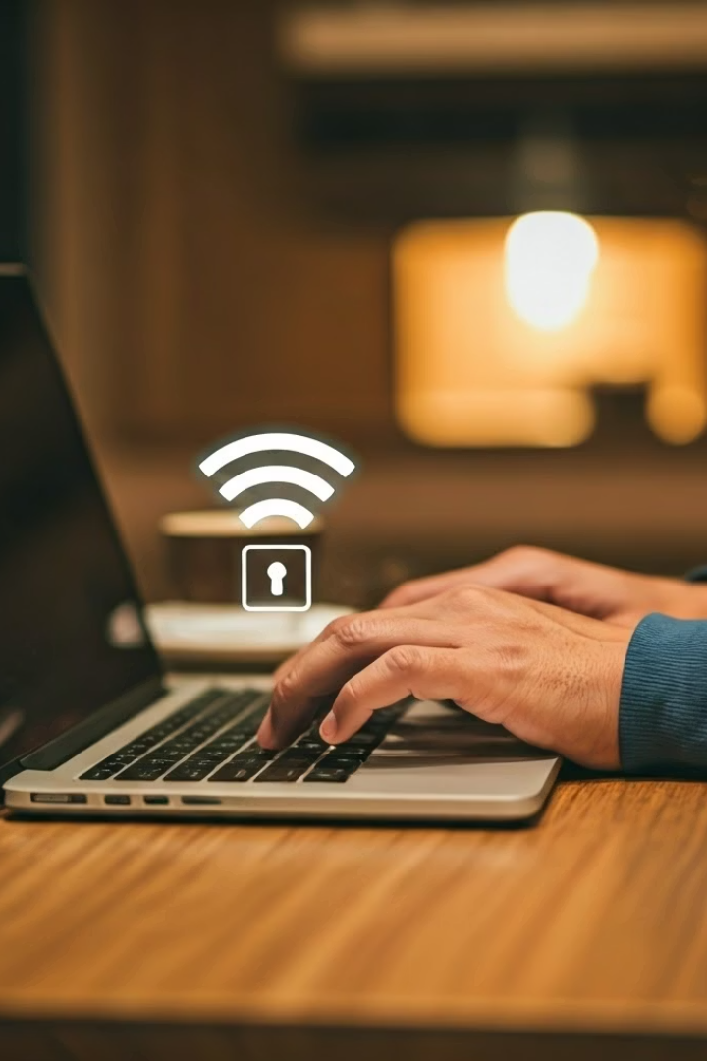



Be Careful on Public Wi-Fi
Public Wi-Fi Risks
Use VPN for Protection
Home
Network Security
Public Wi-Fi (in cafes or airports) is not always safe.
If needed, use a VPN (Virtual Private Network) for more safety.
At home:
Secure your Wi-Fi with a strong password.
Avoid logging in to bank accounts or making online payments on public networks.
Change the default router password (many hackers know these).

Slide 10






Backup Important Files
Cloud Storage
Save copies of photos/documents in Cloud storage (Google Drive, iCloud).
Understand the Risk
Ransomware can lock your files until you pay hackers.
Physical Backup
Use An external hard drive for additional security.

Slide 11
Log Out of Shared Devices
1
Always Log Out
2
Don't Save Passwords
Always log out of your email and accounts when using a public or shared computer.
Never save your password on computers that are not yours.

Slide 12



Talk to Someone if You Feel Unsafe
Recognize the problem
1
If someone online threatens, bullies, or scams you
Seek help
2
Tell a trusted adult or contact cyber help lines
Take action
3
Report and block the person if needed

Slide 13
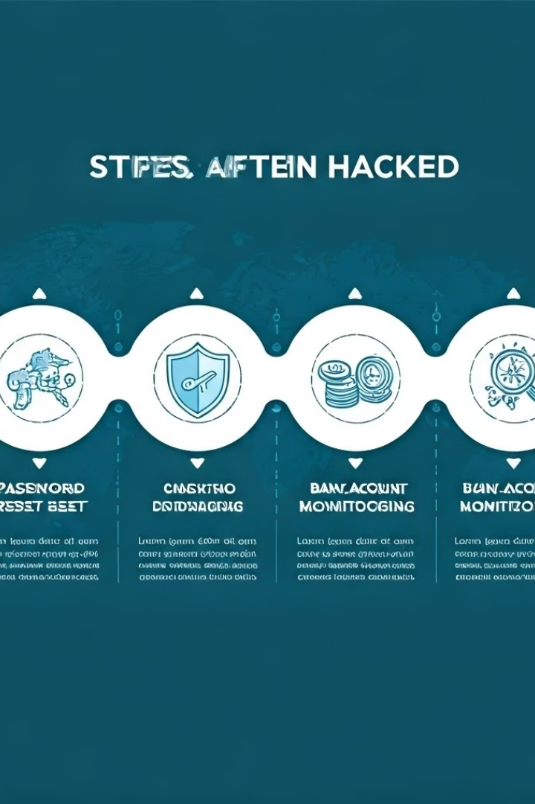
What to Do If Hacked
1
Change Passwords
Change passwords immediately.
2
Enable 2FA
Enable 2FA if not already on.
3
Check Accounts
Check bank accounts for unusual activity.
4
Scan & Report
Scan for viruses.
Report scams to authorities (e.g., FTC in the U.S.).

Slide 14
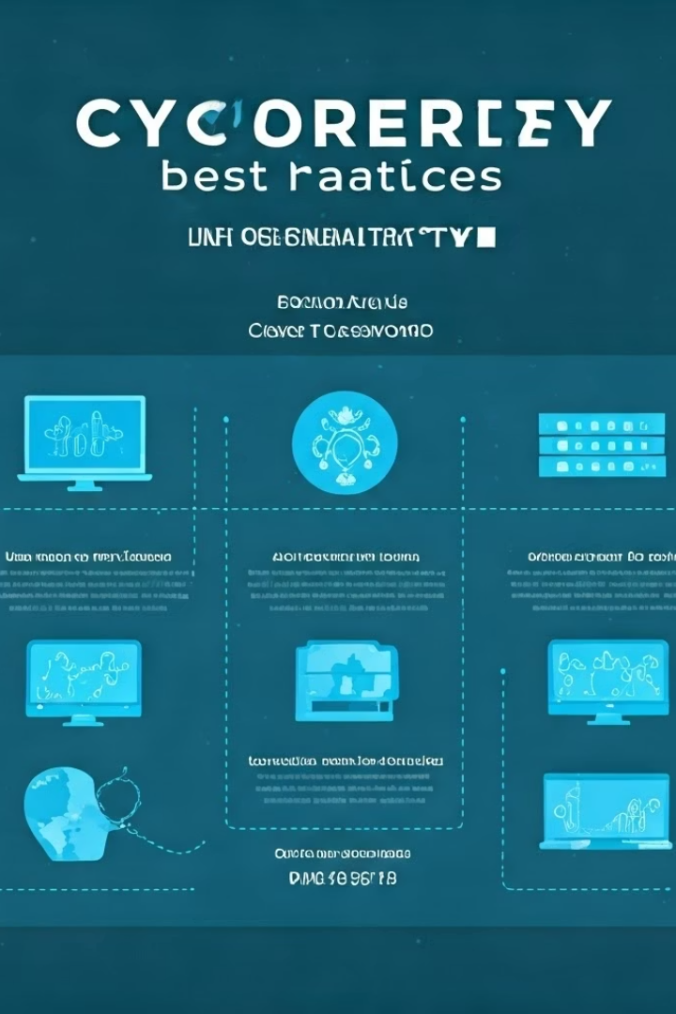
Final Safety Checklist
Use strong, unique passwords.
Turn on 2FA everywhere.
Don't click suspicious links.
Update software regularly.
Avoid public Wi-Fi for sensitive tasks.
Back up important files.
By following these steps, you'll significantly reduce risks and browse safely! 🔒

